Slide 1
GRAPHS

Slide 2
Definition
A graph G consists of two sets
a finite, nonempty set of vertices V(G)
a finite, possible empty set of edges E(G)
G(V,E) represents a graph
An undirected graph is one in which the pair of vertices in a edge is unordered, (v0, v1) = (v1,v0)
A directed graph is one in which each edge is a directed pair of vertices, <v0, v1> != <v1,v0>
tail
head

Slide 3
Examples for Graph
0
0
0
1
2
1
2
1
3
3
4
5
6
G1
2
G2
complete graph
incomplete graph
G3
V(G1)={0,1,2,3} E(G1)={(0,1),(0,2),(0,3),(1,2),(1,3),(2,3)}
V(G2)={0,1,2,3,4,5,6} E(G2)={(0,1),(0,2),(1,3),(1,4),(2,5),(2,6)}
V(G3)={0,1,2} E(G3)={<0,1>,<1,0>,<1,2>}
complete undirected graph: n(n-1)/2 edges
complete directed graph: n(n-1) edges

Slide 4
Types of Graphs
Directed Graph
Undirected Graph
Complete Graph
Cyclic Graph
Acyclic Graph
Simple Graph.

Slide 5
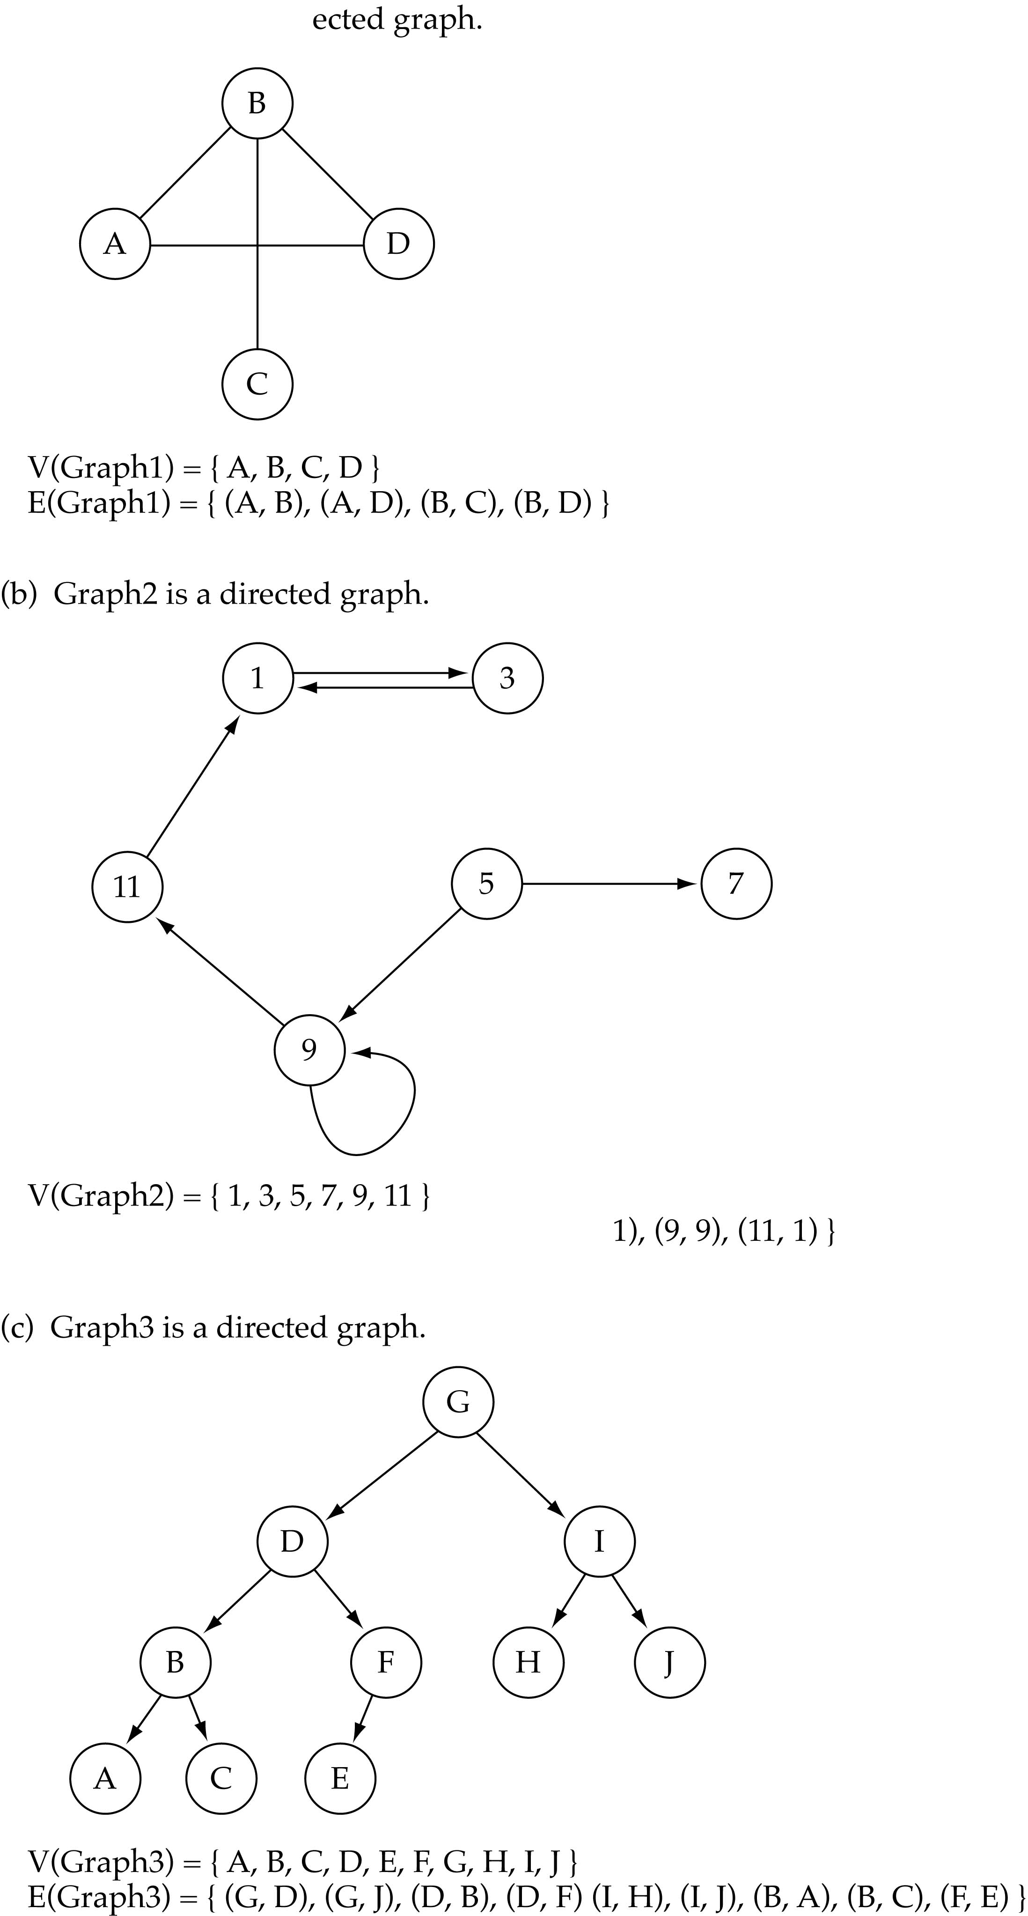
Directed vs. undirected graphs
When the edges in a graph have no direction, the graph is called undirected

Slide 6
Directed vs. undirected graphs (cont.)
When the edges in a graph have a direction, the graph is called directed (or digraph)
Warning: if the graph is directed, the order of the vertices in each edge is important !!
E(Graph2) = {(1,3) (3,1) (5,9) (9,11) (5,7)

Slide 7
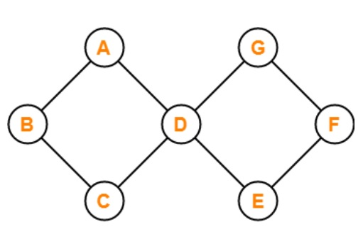
Cyclic Graph
For a graph to be called a cyclic graph, it should consist of at least one cycle. If a graph has a minimum of one cycle present, it is called a cyclic graph.
The graph shown in the image has two cycles present, satisfying the required condition for a graph to be cyclic, thus making it a cyclic graph.

Slide 8
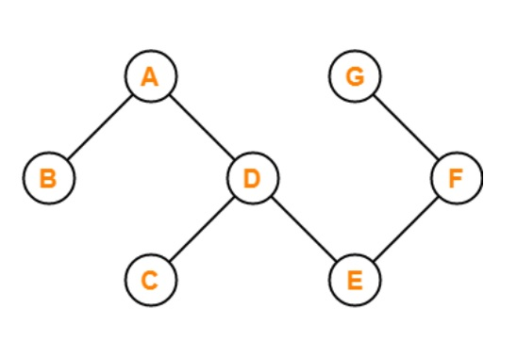
Acyclic Graph
A graph is called an acyclic graph if zero cycles are present, and an acyclic graph is the complete opposite of a cyclic graph.

Slide 9
Acyclic Graph (contd…)
The graph shown in the above image is acyclic because it has zero cycles present in it. That means if we begin traversing the graph from vertex B, then a single path doesn't exist that will traverse all the vertices and end at the same vertex that is vertex B.

Slide 10
Trees vs graphs
Trees are special cases of graphs!!

Slide 11
Graph terminology
Adjacent nodes: two nodes are adjacent if they are connected by an edge
Path: a sequence of vertices that connect two nodes in a graph
Complete graph: a graph in which every vertex is directly connected to every other vertex
5 is adjacent to 7
7 is adjacent from 5

Slide 12
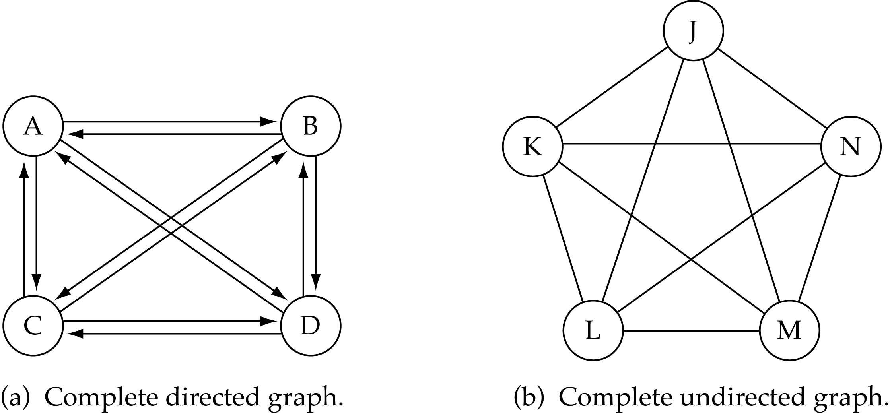
Graph terminology (cont.)
What is the number of edges in a complete directed graph with N vertices?
N * (N-1)

Slide 13
Graph terminology (cont.)
What is the number of edges in a complete undirected graph with N vertices?
N * (N-1) / 2

Slide 14
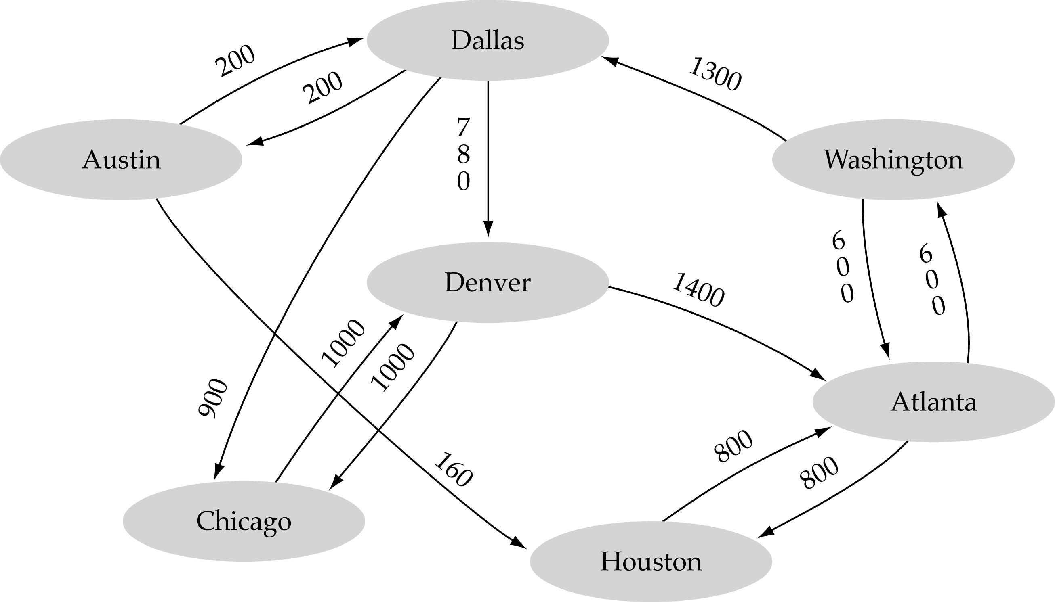
Graph terminology (cont.)
Weighted graph: a graph in which each edge carries a value

Slide 15
Complete Graph
A complete graph is a graph that has the maximum number of edges
for undirected graph with n vertices, the maximum number of edges is n(n-1)/2
for directed graph with n vertices, the maximum number of edges is n(n-1)
example: G1 is a complete graph

Slide 16
Adjacent and Incident
If (v0, v1) is an edge in an undirected graph,
v0 and v1 are adjacent
The edge (v0, v1) is incident on vertices v0 and v1
If <v0, v1> is an edge in a directed graph
v0 is adjacent to v1, and v1 is adjacent from v0
The edge <v0, v1> is incident on v0 and v1

Slide 17
Figure 6.3
*Figure 6.3:Example of a graph with feedback loops and a
multigraph (p.260)
0
0
2
1
3
1
2
self edge
multigraph:
multiple occurrences
of the same edge
(a)
(b)

Slide 18
Subgraph and Path
A subgraph of G is a graph G’ such that V(G’) is a subset of V(G) and E(G’) is a subset of E(G)
A path from vertex vp to vertex vq in a graph G, is a sequence of vertices, vp, vi1, vi2, ..., vin, vq, such that (vp, vi1), (vi1, vi2), ..., (vin, vq) are edges in an undirected graph
The length of a path is the number of edges on it

Slide 19
Figure 6.4: subgraphs of G₁ and G₃ (p.261)
0
0
0
1
2
0
1
2
1
2
3
1
2
3
3
G1
(i) (ii) (iii) (iv)
(a) Some of the subgraph of G₁
0
0
0
0
0
單一
1
1
1
1
分開
2
2
2
(i) (ii) (iii) (iv)
(b) Some of the subgraph of G₃
G3

Slide 20
Simple Path and Style
A simple path is a path in which all vertices, except possibly the first and the last, are distinct
A cycle is a simple path in which the first and the last vertices are the same
In an undirected graph G, two vertices, v0 and v1, are connected if there is a path in G from v0 to v1
An undirected graph is connected if, for every pair of distinct vertices vi, vj, there is a path from vi to vj

Slide 21
connected
0
0
1
2
1
2
3
3
4
5
6
G1
G2
tree (acyclic graph)

Slide 22
Connected Component
A connected component of an undirected graph is a maximal connected subgraph.
A tree is a graph that is connected and acyclic.
A directed graph is strongly connected if there is a directed path from vi to vj and also from vj to vi.
A strongly connected component is a maximal subgraph that is strongly connected.

Slide 23
A graph with two connected components
connected component (maximal connected subgraph)
H₁
0
H₂
4
2
1
5
3
6
7
G₄ (not connected)

Slide 24
Strongly connected components of G₃
strongly connected component
(maximal strongly connected subgraph)
not strongly connected
0
0
2
1
1
2
G3

Slide 25
Degree
The degree of a vertex is the number of edges incident to that vertex
For directed graph,
the in-degree of a vertex v is the number of edges that have v as the head
the out-degree of a vertex v is the number of edges that have v as the tail
if di is the degree of a vertex i in a graph G with n vertices and e edges, the number of edges is

Slide 26
undirected graph
degree
3
0
0
2
1
2
3
1
2
3
3
3
3
4
5
6
3
3
1
G1
1
G2
1
1
0
in:1, out: 1
directed graph
in-degree
out-degree
1
in: 1, out: 2
2
in: 1, out: 0
G3

Slide 27
ADT for Graph
structure Graph is
objects: a nonempty set of vertices and a set of undirected edges, where each edge is a pair of vertices
functions: for all graph ∈ Graph, v, v₁ and v₂ ∈ Vertices
Graph Create()::=return an empty graph
Graph InsertVertex(graph, v)::= return a graph with v inserted. v has no incident edge.
Graph InsertEdge(graph, v1,v2)::= return a graph with new edge between v1 and v2
Graph DeleteVertex(graph, v)::= return a graph in which v and all edges incident to it are removed
Graph DeleteEdge(graph, v1, v2)::=return a graph in which the edge (v1, v2) is removed
Boolean IsEmpty(graph)::= if (graph==empty graph) return TRUE
else return FALSE
List Adjacent(graph,v)::= return a list of all vertices that are adjacent to v

Slide 28
Graph Representations
Adjacency Matrix
Adjacency Lists
Adjacency Multilists

Slide 29
Adjacency Matrix
Let G=(V,E) be a graph with n vertices.
The adjacency matrix of G is a two-dimensional n by n array, say adj_mat
If the edge (vi, vj) is in E(G), adj_mat[i][j]=1
If there is no such edge in E(G), adj_mat[i][j]=0
The adjacency matrix for an undirected graph is symmetric; the adjacency matrix for a digraph need not be symmetric

Slide 30
Examples for Adjacency Matrix
0
0
4
0
2
1
5
1
2
3
6
3
1
7
2
G2
G1
symmetric
undirected: n²/2
directed: n²
G4

Slide 31
Merits of Adjacency Matrix
From the adjacency matrix, to determine the connection of vertices is easy
The degree of a vertex is
For a digraph, the row sum is the out_degree, while the column sum is the in_degree

Slide 32
Data Structures for Adjacency Lists
Each row in adjacency matrix is represented as an adjacency list.

Slide 33
0
0
4
2
1
5
1
2
3
6
3
7
0
1
2
3
1
2
3
0
1
2
3
4
5
6
7
1
2
0
2
3
0
3
0
1
3
0
3
0
1
2
1
2
G1
0
5
4
6
0
1
2
1
5
7
0
2
1
6
G3
G4
2
An undirected graph with n vertices and e edges ==> n head nodes and 2e list nodes

Slide 34
Some Graph Operations
Traversal Given G=(V,E) and vertex v, find all w∈V, such that w connects v.
Depth First Search (DFS) preorder tree traversal
Breadth First Search (BFS) level order tree traversal
Connected Components
Spanning Trees

Slide 35
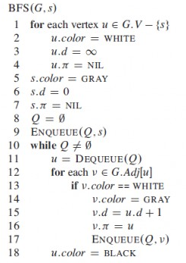

Slide 36
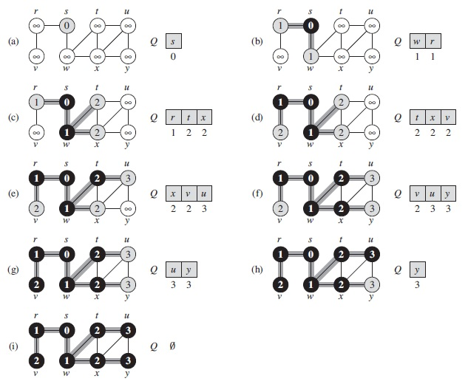

Slide 37
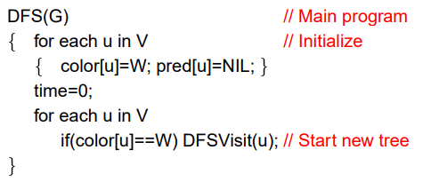
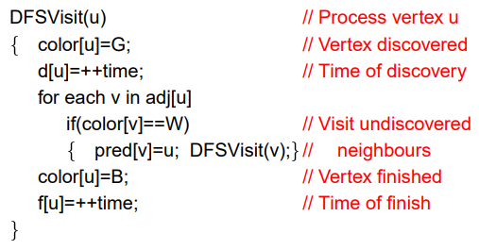

Slide 38
